Slide 1
Hotel Booking Cancellation Prediction
Decision Systems, Random Forests
3/10/24

Slide 2
Contents / Agenda
Executive Summary
Business Problem Overview and Solution Approach
EDA Results
Data Preprocessing
Model Performance Summary
Appendix

Slide 3
Executive Summary
  Recommendation:
  From the data, the Client should utilize the Pruned Random Forest to aggregate its data into understanding the factors that lead to a Cancellation
  The client should understand how other variables such as Special Requests and Meal Plans can improve the number of Arrivals – this would especially be helpful in the Summer when the Cancellations are highest, but the number of Arrivals is around the average
Rationale:
Lead Time carried the greatest weight and was the Root Node for each process
The Pruned Random Forest took the longest time to execute (~3.5 minutes)
The Pruned Random Forest had the lowest Δ between the Training and Testing dataset accuracy.
    The Training dataset accuracy for the other 3 models were in the high 90%
    The accuracy in the Testing set was much lower in the 80’s
    The accuracy for the Pruned Random Forest was 87.32% in the Training set and 85.04% in the Testing set

Slide 4
Business Problem Overview and Solution Approach
Please define the problem
  Historically, hotel cancellations have been an area of concern for overall revenue because hotels are unable to determine with great precision, the likelihood that a reservation will be cancelled. If the reservation is cancelled, the hotel will lose money depending on how close it is to the check-in date. To better understand if a cancellation will occur, we will need to better understand the other variables and their correlation to a cancellation.
Please mention the solution approach / methodology
  We will determine the likelihood that a customer will cancel their reservation by using Decision Trees and Random Forests to understand the factors that lead to a cancellation.
  Our Root Node is Lead time, but we will measure other factors such as Arrival Month, Special Requests, Meal Plan, Price, and Number of Adults
  We will first conduct the Decision Tree process before using the pruned Decision Tree
  Second, we will conduct the Random Forest process before using the pruned Random Forest

Slide 5
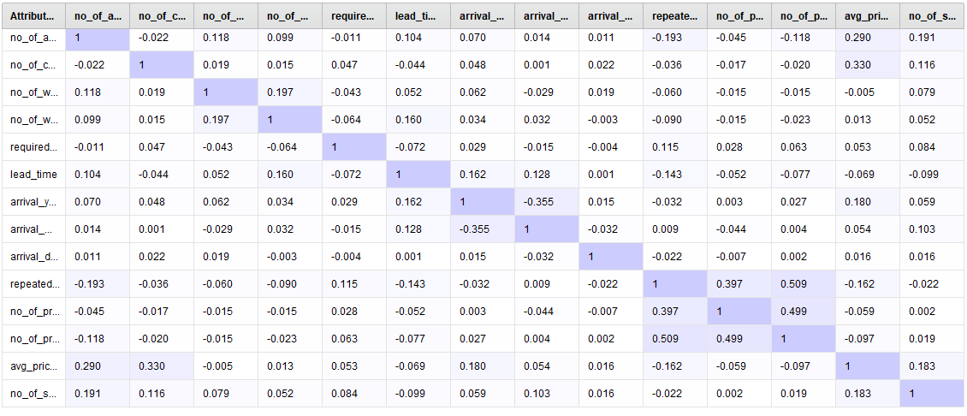
EDA Results
Total Processing Time
The chart on the right shows the amount of time it took to conduct each process. From the chart, we can see that the Pruned processes took significantly longer than the unpruned processes. Additionally, the Decisions Trees took much less time than the Random Forest processes.
Correlation Matrix
The Correlation Matrix shows us which variables have Strong and Weak relationships. In the chart, we can see Repeated Cancellations and Previous Cancellations are highly correlated with Previous Bookings Not Cancelled: 0.509 and 0.499, respectively
Total Processing Time
Process | Time to Execute (min:sec)
Decision Tree | 0:01
Decision Tree – Pruned | 0:18
Random Forest | 0:05
Random Forest – Pruned | 3:29

Slide 6
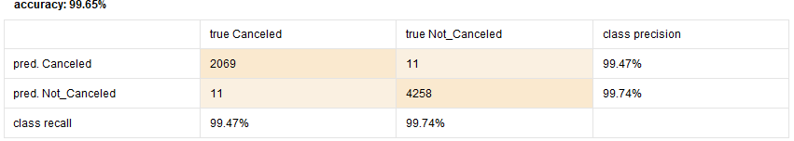
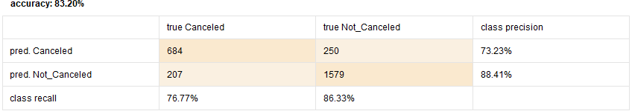
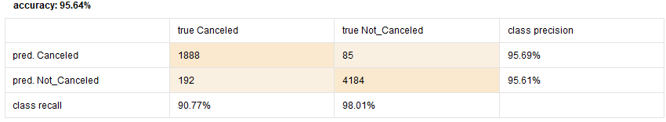

EDA Results (decision tree)
In the chart below we can see the performance chart for the Pruned and Not Pruned Decision Trees.
We can see that while the Accuracy of both Training data sets is 95%+, the Accuracy greatly falls for the Testing data sets below 85%.
The precision fell significantly from 95%+ in the Training sets, to below 88% for the Testing sets.
 | Training | Testing
Not Pruned
Pruned

Slide 7
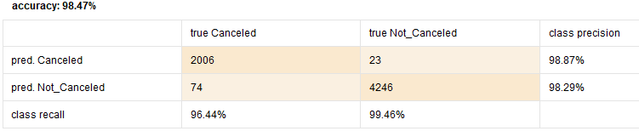


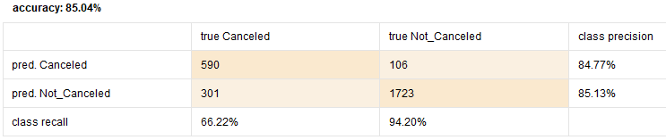
EDA Results (random forest)
In the Not Pruned Random Forest, the Accuracy improves in the Testing set, while retaining a high accuracy in the Training set. However, the precision falls from 98%+ to below 90%.
The Pruned Random Forest has a lower accuracy and precision in the Training dataset, but the Δ is the smallest between both the Training and Testing data sets
The Recall was very high for Not Cancelled, which indicates that it could find those values well.
 | Training | Testing
Not Pruned
Pruned

Slide 8
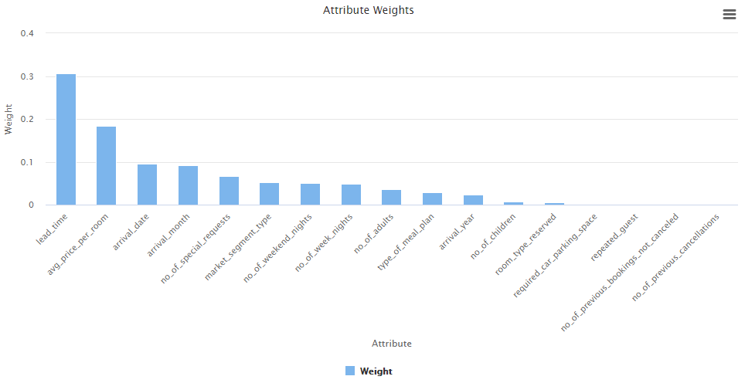
Model Performance Summary
Overview of the final ML model and its parameters
  The Pruned Random Forest created 80 trees in 3:29 minutes
  Lead Time had the greatest weight, which also caused it to be the Root Node in majority of scenarios
  Other Attributes that had a weight of significance (>.005) had a tree created where it was the Root Node
Summary of most important features used by the ML model for prediction
  The Random Forest had a smaller Δ between Testing and Training Group Accuracy, which means we are minimizing the Overfitting of the model
Note: You can use more than one slide if needed

Slide 9
APPENDIX

Slide 10
Data Background and Contents
Please mention the data background and contents
The data consistent in this assingment is the Customer booking details for INN Hotels Group
The data is distinct on the Booking ID as its Primary Key
It also highlights other details such as the number of Adults and Children, when the Booking occurred, and whether previous Cancellations had occurred

Slide 11
Model Building - Decision Tree / Random Forest
Comment on the model performance of Decision Tree / Random Forest
The best model for our objective is the Pruned Random Forest because it has the lowest variability in Accuracy, Recall, and Precision amogst the 4 models. Specifically, we want to limit the variance in Recall because we want to correctly yield Cancellation data.
We were able to come to this conclusion because we can measure and change the weights of our Attributes in the model, and in the case of the Pruned Random Forest, aggregate the data
Note: You can use more than one slide if needed

Slide 12
Slide Header
Please add any other pointers (if needed)

