Slide 1
SPAM
Natural Language Processing (NLP)
4/10/24

Slide 2
Contents / Agenda
Data Dictionary
Business Problem Overview and Solution Approach
Exploratory Data Analysis
Model Performance Summary
Insights & Recommendations
Appendix

Slide 3
Data Dictionary
Category: Contains the labels 'spam' or 'ham' for the corresponding text data
Message: Contains the SMS text data

Slide 4
How to use this deck?
This slide deck serves as a comprehensive template for your project submission
Within this deck, you will come across various questions that are intended to test your ability to understand data visualizations, discover patterns / insights and postulate hypothesis. Think thoroughly and provide answers to these questions
You are encouraged to modify this deck as required, by replacing the questions with suitable answers
Please feel free to incorporate additional points if you deem necessary
Note: The data visualizations you see in this deck are obtained from RapidMiner

Slide 5
Business Problem Overview and Solution Approach
Please define the problem
  Spam is a major issue in Personal Privacy and Security with respect to Technological innovations such as Short Messaging Services (SMS). SMS spam specifically, is the act of sending unsolicited messages containing advertising (not harmful) as well as malicious (harmful) links. As a Data Science Manager at Cyber Solutions, I have been tasked with utilizing Natural Language Processing (NLP) to identify and classify those malicious messages prior to our employees receiving them on their phones.
Please mention the solution approach / methodology
  We are working with only 2 columns in our data set, Category and Message. Our objective will be to create a decision system that can correctly filter the SMS messages as safe or unsafe. If the messages are safe, then we will let them get pushed to employee phones. If they are unsafe, we will restrict them at the ‘point of entry.’ To create this process, we will utilize techniques such as NLP – diving into the morphology of the message context and continue to refine our model based on the training and testing data results.

Slide 6
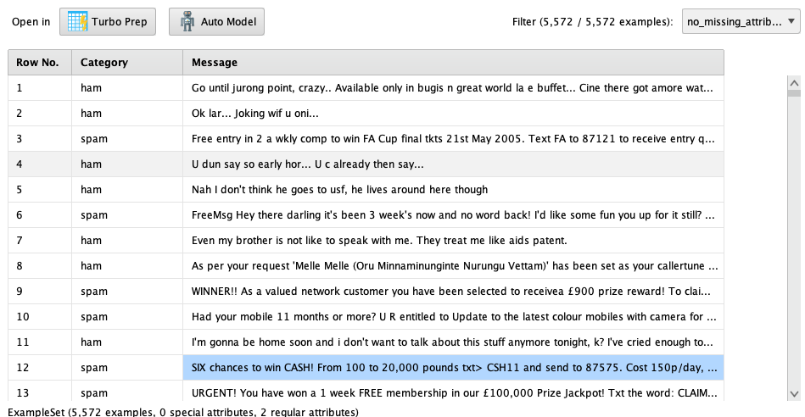
EDA
Provide a brief overview of the raw dataset

Slide 7
EDA
Provide a brief overview of the raw dataset
  The dataset displays 3 columns (Row No., Category, and Message) with 5,572 rows of data
    Row. No is an automatically assigned digit based on the row
    Category has two values: Ham for acceptable messages, and Spam for malicious messages
    Message contains free-text which is where we will look to determine if something is Ham or Spam
  Of the 5,572 rows of data:
    Ham consists of 747 rows, or 13.4% of the total dataset
    Spam consist of 4825 rows, or 86.6% of the total dataset
    There are no blank values, indicating a complete dataset

Slide 8
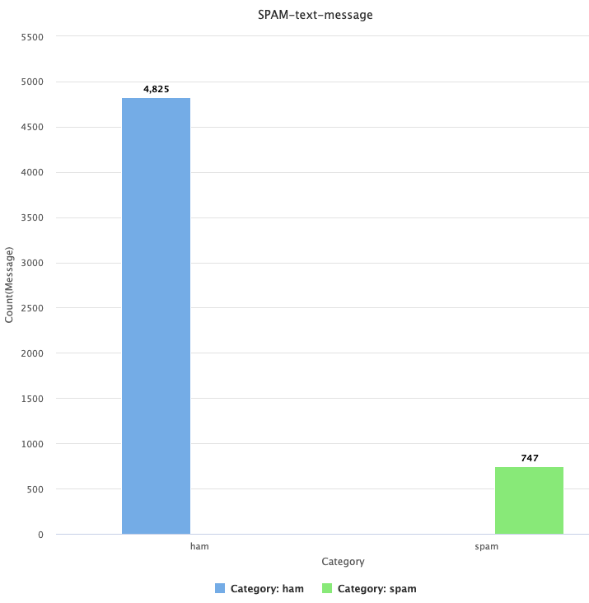
EDA
What is the percentage of ham and spam messages in the dataset? How can we handle the imbalance in the dataset?
    Ham consists of 747 rows, or 13.4% of the total dataset
    Spam consist of 4825 rows, or 86.6% of the total dataset
    There are no blank values, indicating a complete dataset
    Given the large difference in Ham and Spam, we should first look to the Spam dataset to make sure that it is correctly filtering and withholding malicious emails, while sending approved messages

Slide 9
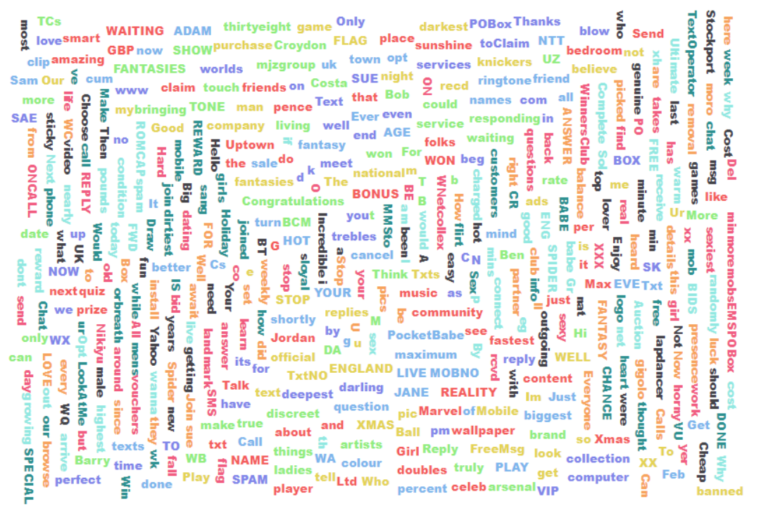
EDA: Word Cloud for Spam messages
The below illustration is commonly used when working with textual data. What is this illustration called? How does it help solve the problem statement? When is it used?

Slide 10
EDA: Word Cloud for Spam messages
The below illustration is commonly used when working with textual data. What is this illustration called? How does it help solve the problem statement? When is it used?
The illustration is a Word Cloud which is normally used to depict the words in a particular set of text or dataset. In this specific example, the words are in an unstructured format and appear to all be the same size, indicating they all have equal weight or are unique.
This image can help us because it is providing a consolidated view of all the words available in one central place. As a result, we can now start to pick off words one by one and put them in either the Spam or Ham bucket, respectively.
Word Clouds are helpful because they display all of the text to us, and by using lemmatization, can normalize all words to their root form which helps us remove Stop Words as well. We can also do a count on the frequency of certain words to determine their weight in the total population.

Slide 11
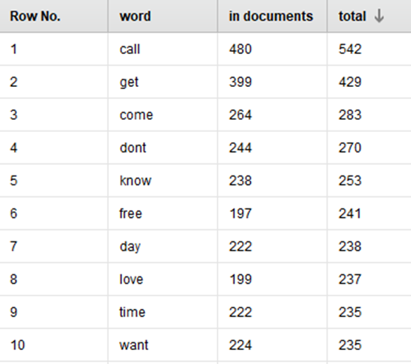
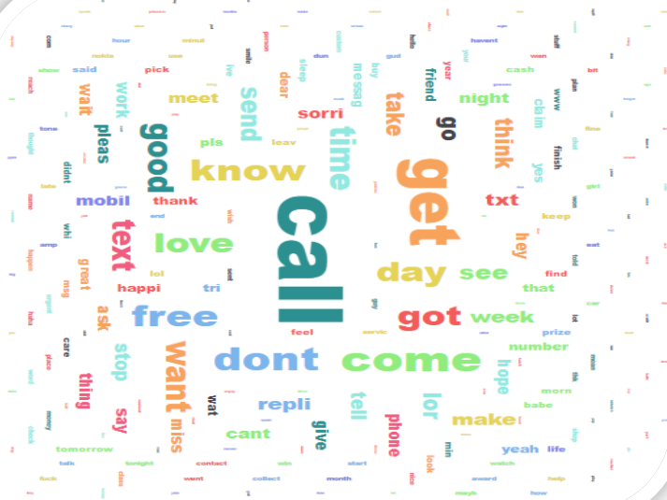
Text Analysis
Which text analysis technique is used to find the frequencies of words occurring in documents? How does it help solve a problem statement?

Slide 12
Text Analysis
Which text analysis technique is used to find the frequencies of words occurring in documents? How does it help solve a problem statement?
To better understand the data in this image, we can utilize the Inverse Document Frequency to take our complete, unique set of words and run them against the number of documents (SMS messages) that they appear in.
Using this information, we can then take the log of these fractions (i.e. the total number of documents/the number of documents containing a word).
Once we have the Term Frequency and the Inverse Document Frequency for each unique word, we can calculate the weight by multiplying them together. This product will indicate to us, which words to pay more attention to first.

Slide 13
Text Analysis
Which text analysis technique is used to find the frequencies of words occurring in documents? How does it help solve a problem statement?
To better understand the data in this image, we can utilize Clustering to group all the words together and visually depict which words appear the most.
This is feasible because we can set the weight of a certain word to the number of times it appears in a dataset (e.g. if a dataset contained 100 words – either Ham: 20 or Spam: 80, Spam appears 4x more than Ham, so it would appear to be 4x bigger – example below.
Understanding this data is helpful to our analysis because we have proof that certain words appear at a higher frequency in malicious emails as opposed to approved emails, which will help us train our model to flag those words (in this specific case: Call and Get).
SPAM (Size: 56) | HAM (Size:14)

Slide 14
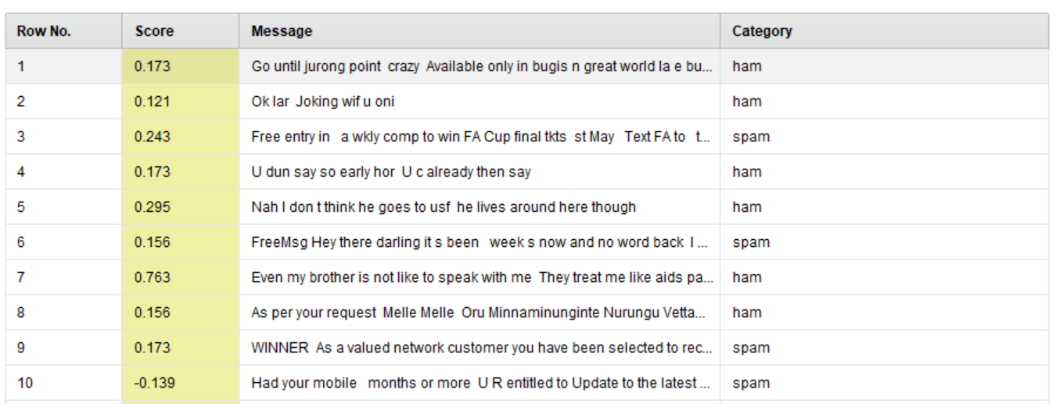
Text Analysis
What is the technique used to determine the sentiment of a piece of textual data? How can positive and negative scores be used to determine the sentiment? How is it helpful in solving business problems?

Slide 15
Text Analysis
What is the technique used to determine the sentiment of a piece of textual data? How can positive and negative scores be used to determine the sentiment? How is it helpful in solving business problems?
The better understand the sentiment of textual data, we can do a sentiment analysis to understand whether certain words contain more malice than others.
In this example, we can see that the Spam messages all contained words such as: Free, (Win)ner, and entitled, whereas Ham messages did not contain those specific words.
However, we can see that our model has given a high Sentiment score to rows 3 and 5, indicating that we need to refine our model a bit further. Analyzing the data further, it can be inferred that a significant amount of Ham messages have relatively equal Sentiment scores to Spam messages.
To solve our problem better, we now know that we will need to refine our model further to better understand and classify what is Spam vs. Ham.

Slide 16
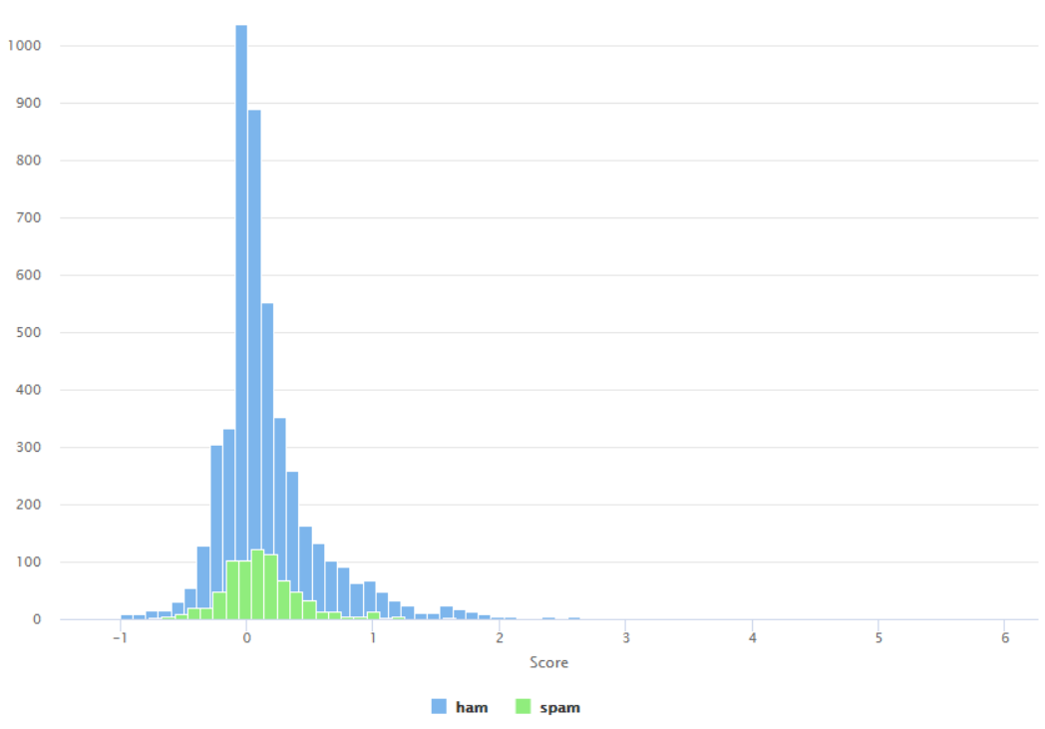
Sentiment Scores for Spam and Ham texts
From a business perspective, why is it important to analyze the sentiment scores of both spam and ham messages in SMS communication? How does the difference in sentiment scores between spam and ham messages provide valuable insights for preventing cyber attacks through SMS?
  It is important to understand the Sentiment scores for both Spam and Ham messages because it will help us refine our model with respect to how we are filtering certain words.
  In the chart to the right, we can see a normal distribution of our entire dataset.
  Ham has a much sharper slope towards zero, from both sides. Whereas Spam does not have as big of a distribution and with a tamer slope.
  This tells us that Ham has a greater concentration of words around the mean compared Spam.
  This tells us that our model has too many words that it is accepting and needs refinement.

Slide 17
Model Performance Evaluation Decision Tree
Please comment on the model performance of the Decision Tree Model
  Overall, the model seems to be performing well
  This is because the Training Accuracy, Recall, and Precision are 90%+, and the Testing Accuracy, Recall, and Precision are very close to the training percentages (all 90%+)
  We have an extremely high accuracy (95%+) for both our Training and Testing data, so we can say that our model is doing a great job at correctly predicting Spam and Ham outcomes
  This is bolstered with a high precision – both Training and Testing are around 95% indicating that our model is often correct with its positive predictions – correct with Spam and Ham
  While our Recall is high (90%+), they are lower than the Training and Accuracy, pointing to an area that can be improved. But our model is doing a good job at finding the instances of Spam and Ham
Model | Train Accuracy | Test Accuracy | Train Recall | Test Recall | Train Precision | Test Precision
Decision Tree | 97.22 | 96.59 | 92.03 | 91.50 | 95.71 | 93.50

Slide 18
Model Performance Evaluation Pruned Decision Tree
From the company’s perspective, how do the performance metrics of the decision tree model, both before and after pruning, impact the effectiveness of the SMS spam detection system?
After Pruning our model, we can see that its performance has decreased overall
Our Training and Testing Accuracy have both fallen approximately 1.5-2%
Our Training and Testing Recall have both fallen 0.25-.5%
Our Training and Testing Precision have both fallen, Training – 1.75%; Testing – 5%+
Model | Train Accuracy | Test Accuracy | Train Recall | Test Recall | Train Precision | Test Precision
Decision Tree Before Pruning | 97.22 | 96.59 | 92.03 | 91.50 | 95.71 | 93.50
Decision Tree - Pruned | 96.75 | 94.79 | 91.76 | 89.90 | 93.96 | 88.18

Slide 19
Model Performance Evaluation Random Forest
Please comment on the model performance of the Random Forest Model
  The Random Forest is working very well with both the Training and Testing Accuracy and Precision, with both 95%+
    However, our Recall is much lower in the mid 80%
  This means that our Random Forest model is doing a great job at correctly predicting Spam and Ham outcomes, and that it is correct with its positive predictions
    However, we need to improve the Recall for both our Training and Testing data, as our model is not doing a good job at finding those positive instances
Model | Train Accuracy | Test Accuracy | Train Recall | Test Recall | Train Precision | Test Precision
Random Forest | 95.83 | 95.42 | 84.45 | 82.89 | 97.70 | 97.49

Slide 20
Model Performance Evaluation Pruned Random Forest
Based on the provided evaluation metrics, how does the performance of the random forest model compare to the pruned random forest model in terms of accuracy, recall, and precision for SMS spam detection?
In the Pruned Random Forest, we see relatively the same performance in the Training Accuracy and Precision, but an improvement in the Training Recall
However, although we have improved our Testing Recall, our Testing Accuracy has slightly fallen (0.75%) and our Testing Precision has fallen nearly 7%!
As a result, this indicates that the Pruned Random Forest is overall not a better model than the Random Forest
Model | Train Accuracy | Test Accuracy | Train Recall | Test Recall | Train Precision | Test Precision
Random Forest before pruning | 95.83 | 95.42 | 84.45 | 82.89 | 97.70 | 97.49
Random Forest - Pruned | 97.49 | 94.70 | 91.70 | 85.31 | 97.32 | 90.78

Slide 21
Model Performance Summary
Description of the ML model that best fits the company’s objective. Also state which evaluation metric (such as accuracy, recall or precision) is important to achieve the business objective and why?
Offer suggestions and advice for the company based on the gathered insights.
Model | Train Accuracy | Test Accuracy | Train Recall | Test Recall | Train Precision | Test Precision
Decision Tree before pruning | 97.22 | 96.59 | 92.03 | 91.50 | 95.71 | 93.50
Decision Tree - Pruned | 96.75 | 94.79 | 91.76 | 89.90 | 93.96 | 88.18
Random Forest before pruning | 95.83 | 95.42 | 84.45 | 82.89 | 97.70 | 97.49
Random Forest - Pruned | 97.49 | 94.70 | 91.70 | 85.31 | 97.32 | 90.78

Slide 22
Model Performance Summary
Description of the ML model that best fits the company’s objective. Also state which evaluation metric (such as accuracy, recall or precision) is important to achieve the business objective and why?
    Offer suggestions and advice for the company based on the gathered insights
    My recommendation to the company is to use the unpruned Decision Tree and work on refining it further to improve the Recall
    It is our best model because it has higher percentages across the board for Accuracy and Recall
      While the Precision is not as high as the Random Forest, it is still high (94-95%)
      Evaluating all these variables holistically, the drop-off with the Random Forest is acceptable because it is much smaller than the drop-offs noticed in the Testing Recall data

Slide 23
Insights and Recommendations
Please mention actionable insights & recommendations
  The unpruned Decision Tree is our best model to use and refine
  To improve it, we can focus on improving the overall Recall, especially in the Testing dataset
  We can do this by tracking our model’s performance overtime, and by taking away the White Noise, we can understand our data objectively without the trends
  We can also use more refined clustering techniques to categorize our data more effectively

Slide 24
Insights and Recommendations
How can sentiment analysis be utilized to address diverse problem statements? In what ways can it be applied across various industries?
  Sentiment analysis is extremely helpful in understanding text data because we can better understand if a message consists of malice or is a positive and more acceptable message
  This is especially critical in the Consumer industry because consumers should have a positive reaction to what is being advertised to them – this is what ultimately drives sales
  In Healthcare, Sentiment analysis is essential because an illness or disease needs to be carefully communicated to a patient so that they do not lose their mind – this is the ethical part of AI/ML

Slide 25
Insights and Recommendations
Select an industry of your choice and pinpoint a prospective issue that could be resolved through text processing. Explain the approach to solving this problem statement.
  A major issue that can be resolved via text processing is in the Advertisement space. Amazon is already aggregating all customer reviews into one consolidated review, which provides a quick snapshot to the buyer
  Likewise, at my current company, Southern Glazers Wine & Spirits, we are the largest liquor and wine distributor in the world. We can utilize text processing to understand how customers felt about certain wines, and make better recommendations of wine to the customers so they can improve sales
  As an example:
    Store A buys 10 cases of Pinot Grigio (white) and 10 cases of Merlot (Red)
    From the tastings they offer in their store, they provide feedback that: the Merlot has the right level of dryness, but it too fruity. Whereas the Pinot Grigio is too sweet.
    From analyzing these types of comments, we can build profiles for the Pinot Grigio and the Merlot so that we communicate to future clients that customers felt the Merlot was fruity, and the Pinot was sweet.

Slide 26

APPENDIX

Slide 27


Happy Learning !
10

